Slide 1

Single-Dimensional Arrays and C-Strings
TUIT
C++ Programming, Fall 2016
Lecture #7
II – part

Slide 2
TUIT
Roadmap
Last week we covered
Single-Dimensional Arrays and C-Strings
This week we will learn
Returning Arrays from Functions
Problem: Counting the Occurrences of Each Letter
Searching Arrays
Sorting Arrays
C-Strings

Slide 3
TUIT
Returning Arrays from Functions
To return an array from a function, pass it as a parameter in a function.
You can declare a function to return a primitive type value or an object. For example,
//Return the sum of the elements in the list
int sum (const int list[], int size)
Can you return an array from a function using a similar syntax? For example, you may attempt to declare a function that returns a new array that is a reversal of an array, as follows:
// newList is the reversal of list
void reverse(const int list[], int size)

Slide 4
TUIT
Returning Arrays from Functions
This is not allowed in C++. However, you can circumvent this restriction by passing two array arguments in the function:
// newList is the reversal of list
void reverse(const int list[], int newList[], int size)

Slide 5
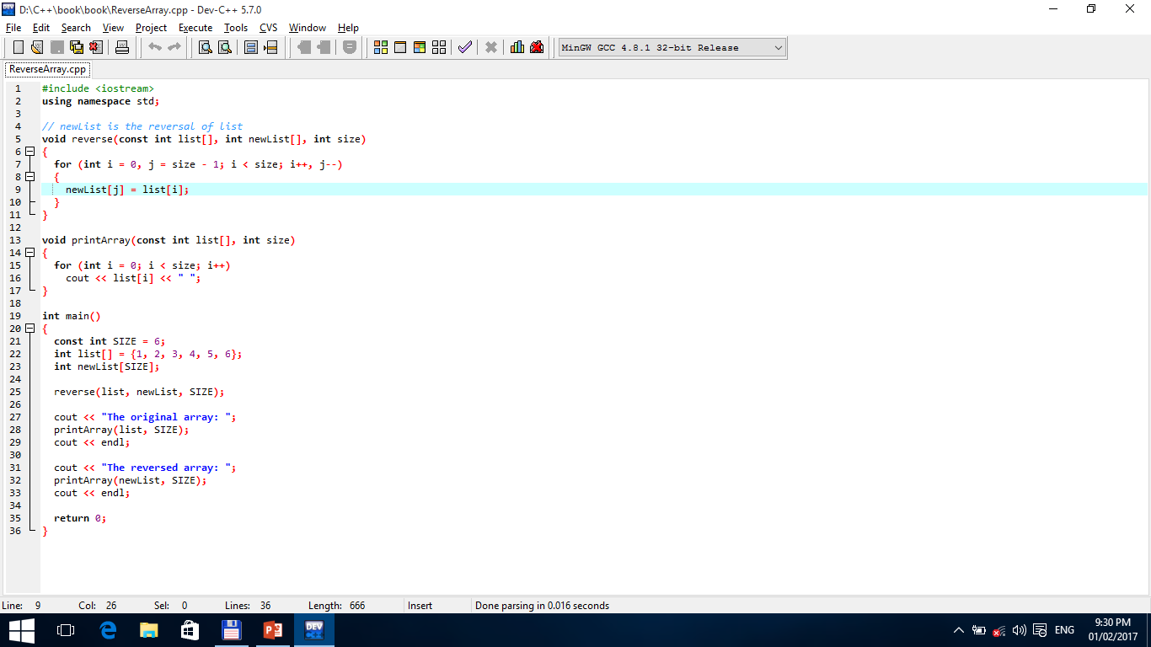

TUIT
Returning Arrays from Functions
The original array: 1 2 3 4 5 6 The reversed array: 6 5 4 3 2 1
list
newList

Slide 6
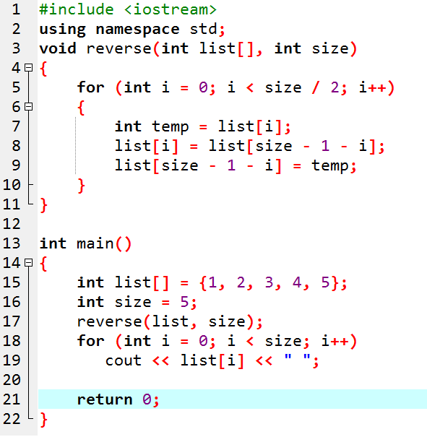
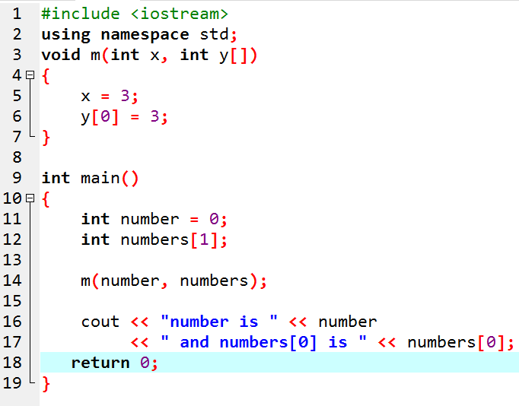
TUIT
Check Point
Show the output of the following two programs:

Slide 7
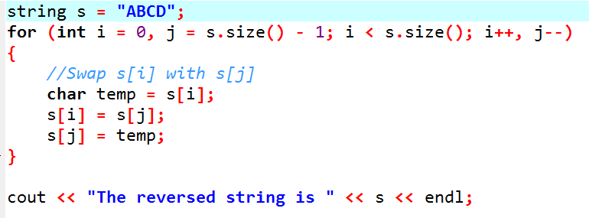
TUIT
Check Point
Suppose the following code is written to reverse the characters in a string, explain why it is wrong.

Slide 8
TUIT
Problem: Counting the Occurrences of Each Letter
This section presents a program to count the occurrences of each letter in an array of characters.
Program does the following:
Generate 100 lowercase letters randomly and assign them to an array of characters.
static_cast<char>(‘a’ + rand() % (‘z’ – ‘a’ + 1))
Count the occurrences of each letter in the array. To do so, declare an array, say counts of 26 int values, each of which counts the occurrences of a letter. That is, counts[0] counts the number of a’s, counts[1] counts the number of b’s, and so on.

Slide 9
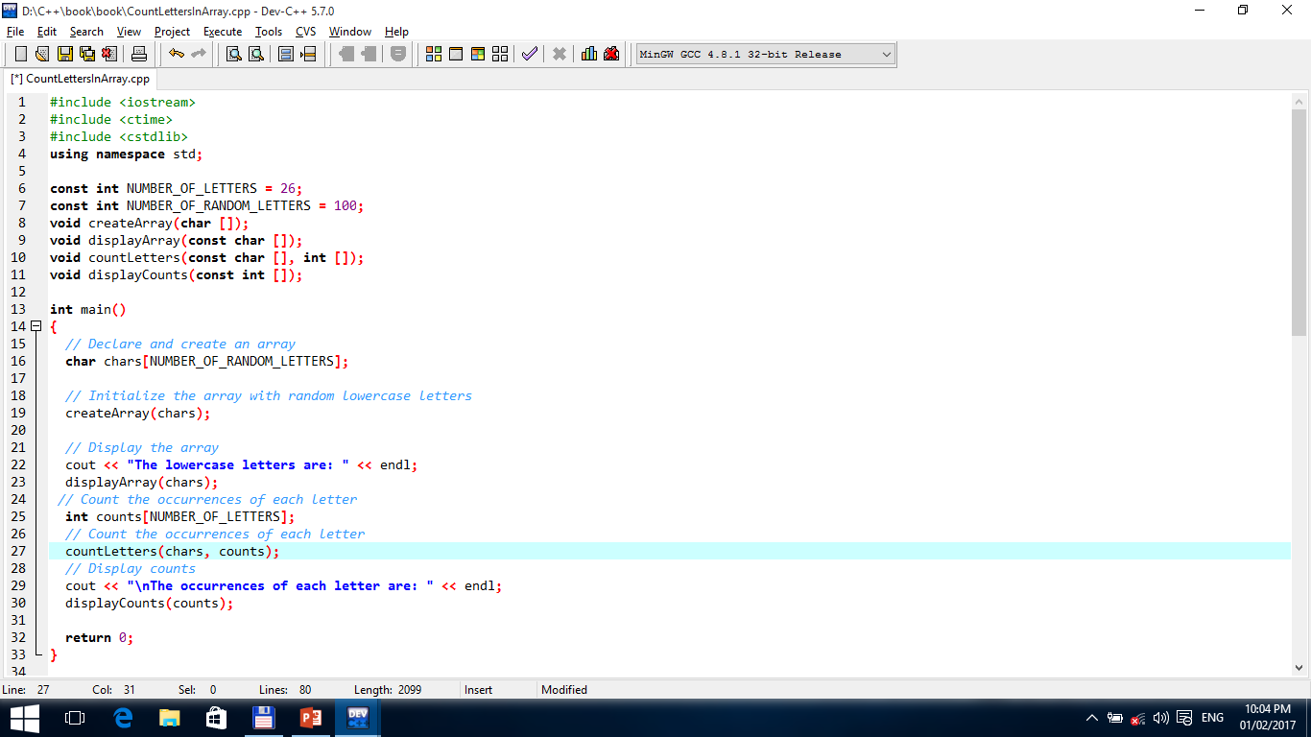
TUIT
Problem: Counting the Occurrences of Each Letter

Slide 10
TUIT
Problem: Counting the Occurrences of Each Letter

Slide 11
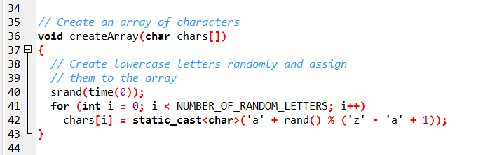
TUIT
Problem: Counting the Occurrences of Each Letter

Slide 12
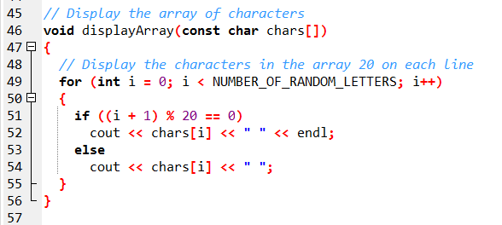
TUIT
Problem: Counting the Occurrences of Each Letter

Slide 13
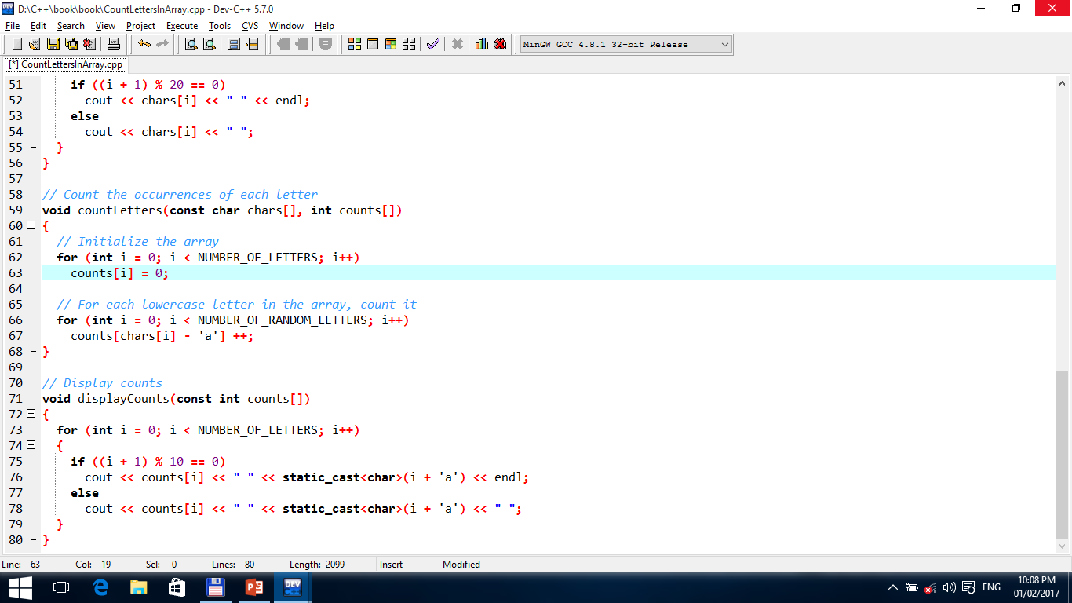
TUIT
Problem: Counting the Occurrences of Each Letter

Slide 14
TUIT
Problem: Counting the Occurrences of Each Letter

Slide 15
TUIT
Problem: Counting the Occurrences of Each Letter
The lowercase letters are: s v g q v d m l y n d d c v f d v k p p s h s j f o s e a v r g z c t u u s o b g t f r u f p f v r z n z a y u k n i n p q k d y h u y g q h f d r y y z t w a t w n w g v z i q a k y q x c d u o h c The occurrences of each letter are: 4 a 1 b 4 c 7 d 1 e 6 f 5 g 4 h 2 i 1 j 4 k 1 l 1 m 5 n 3 o 4 p 5 q 4 r 5 s 4 t 6 u 7 v 3 w 1 x 7 y 5 z

Slide 16
TUIT
Searching Arrays
If an array is sorted, binary search is more efficient than linear search for finding an element in the array.
Searching is the process of looking for a specific element in an array – for example, discovering whether a certain score is included in a list of scores. Searching is a common task in computer programming. Many algorithms and data structures are devoted to searching. This section discusses two commonly used approaches: linear search and binary search.

Slide 17
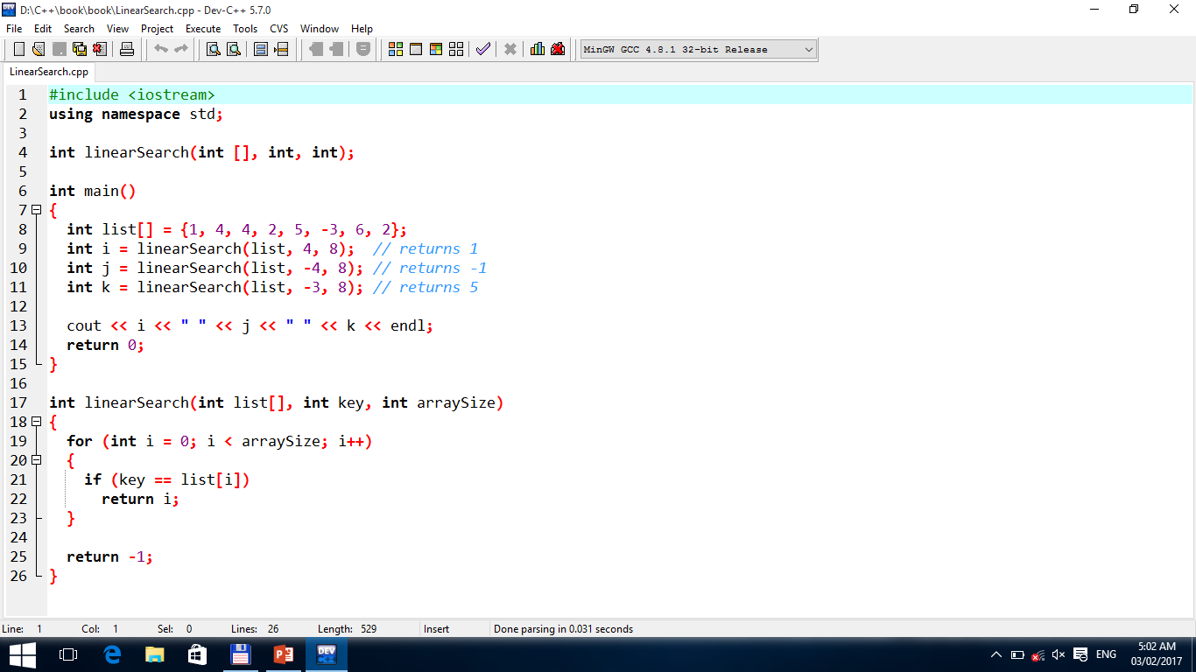
TUIT
The Linear Search Approach
The Linear Search Function

Slide 18
TUIT
The Binary Search Approach
Binary search is the other common search approach for a list of values. It requires that the elements in the array already be ordered. Assume that the array is in ascending order. The binary search first compares the key with the element in the middle of the array. Consider the following cases:
If the key is less than middle element, you only need to continue to search in the first half of the array.
If the key is equal to the middle element, the search ends with a match.
If the key is greater than the middle element, you only need to continue to search in the second half of the array.

Slide 19
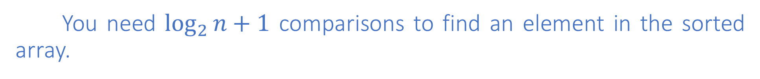
TUIT
The Binary Search Approach
You need $\log_{2}{n}+1$ comparisons to find an element in the sorted array.
1-call
A<K
2-call
A>K
3-call
A=K

Slide 20
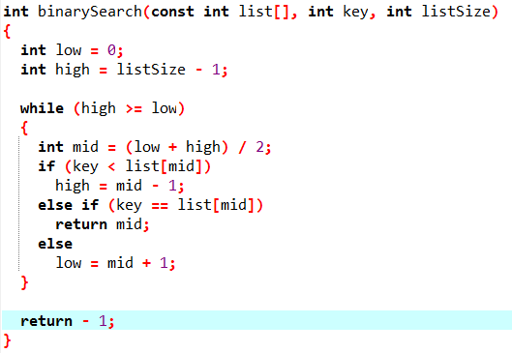
TUIT
The Binary Search Approach

Slide 21
TUIT
Note
Linear search is useful for finding an element in a small array or an unsorted array, but it is inefficient for large arrays. Binary search is more efficient, but requires that the array be presorted.

Slide 22
TUIT
Sorting Arrays
Sorting, like searching, is a common task in computer programming. Many different algorithms have been developed for sorting. This section introduces an intuitive sorting algorithm: selection sort.
Suppose that you want to sort a list in ascending order. Selection sort finds the smallest number in the list and swaps it with the first. It then finds the smallest number remaining and swaps it with the next to fisrt, and so on, until only a single number remains.

Slide 23
TUIT
Selection Sort
i
1
2
3
4
5
6
A(i )
10
4
11
9
7
2
1 - swap
2
4
11
9
7
10
2 - swap
2
4
11
9
7
10
3 - swap
2
4
7
9
11
10
4 -swap
2
4
7
9
11
10
5 - swap
2
4
7
9
10
11

Slide 24
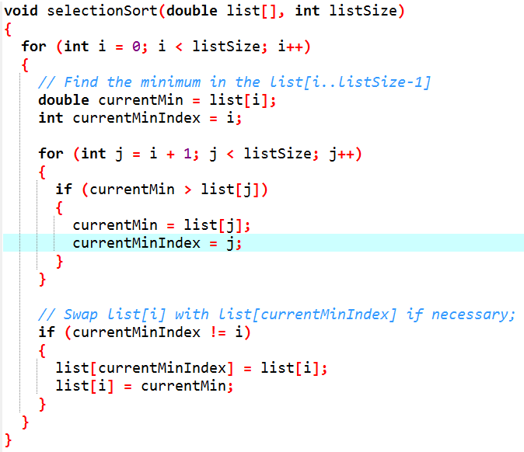
TUIT
Selection Sort

Slide 25
TUIT
C-Strings
C-string is an array of characters that ends with the null terminator character ‘\0’. You can process C-strings using C-string functions in the C++ library.
A C-string is an array of characters ending with the null terminator (‘\0’), which indicates where a string terminates in memory. Recall that a character that begins with the backlash symbol (\) is an escape sequence, “Escape Sequences for Special Characters”. The symbols \ and 0 (zero) together represent one character. This character is the first character in the ASCII table.

Slide 26
TUIT
Pedagogical Note
C-string is popular in the C language, but it has been replaced by a more robust, convenient, and useful string type in C++. For this reason, the string type, introduced in Lecture #4 is used to process strings in this book. The purpose of introducing C-strings in this section is to give additional examples and exercises using arrays and to enable you to work with the legacy C programs.

Slide 27
TUIT
C-Strings
Every string literal is a C-string. You can declare an array initialized with a string literal. For example, the following statement creates an array for a C-string that contains characters ‘D’, ‘a’, ‘l’, ‘l’, ‘a’, ‘s’, and ‘\0’.
char City[7] = “Dallas”;
‘D’
‘a’
‘l’
‘l’
‘a’
‘s’
‘\0’
City[0]
City[1]
City[2]
City[3]
City[4]
City[5]
City[6]
char City1[] = “Dallas”; // C-string
char City2[] = {‘D’, ’a’, ’l’, ’l’, ’a’, ’s’}; // Not a C-string

Slide 28
TUIT
Input and Output of C-strings
To output a C-string is simple. Suppose s is an array for a C-string. To display it to the console, simply use
cout << s;
You can read a C-string from the keyboard just as you do a number. For example, consider the following code:
char city[7];
cout << “Enter a city:”;
cin >> city; // Read to array city
city << “You entered ” << city << endl;

Slide 29
TUIT
Input and Output of C-strings
When you read a string to an array, be sure to leave room for the null terminator character. Since city has a size 7, your input no exceed 6 characters. This approach to reading a string is simple, but there is a problem. The input ends with a whitespace character. You cannot read a string that contains a space. Suppose you want to enter New York; then you have to use an alternative approach. C++ provides the cin.getline function in the iostream header file, which reads a string into an array. The syntax of the function is as follows:
cin.getline(char array[], int size, char delimitChar)

Slide 30
TUIT
Input and Output of C-strings
The function stops reading characters when the delimiter character is encountered or when the size-1 number of characters have been read. The last character in the array is reserved for the null terminator (‘\0’). If the delimiter is encountered, it is read but is not stored in the array. The third argument delimitChar has a default value (‘\n’). The following code uses the cin,getline function to read a string:
char city[30];
cout << “Enter a city: ”; // i.e., New York
cin.getline(city, 30, ‘\n’); // Read to array city
cout << “You entered ” << city << endl;
Since the default value for the third argument in the cin.getline function is ‘\n’, line 3 can be replaced by
cin.getline(city, 30); // Read to array city

Slide 31
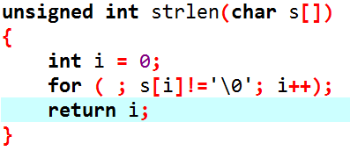
TUIT
C-String Functions
Here is the function for obtaining the length of a C-string:

Slide 32
TUIT
Note
size_t is a C++ type. For most compilers, it is the same as unsigned int.
All these functions are defined in the cstring header file except that conversion functions atoi, atof, and itoa are defined in the cstdlib function.

Slide 33
TUIT
String Functions
Function | Description
size_t strlen(char s[]) | Returns the length of the string, i.e., the number of the characters before the null terminator.
strcpy(char s1[], const char s2[]) | Copies string s2 to string s1.
strncpy(char s1[], const char s2[], size_t n) | Copies the first n characters from string s2 to string s1.
strcat(char s1[], const char s2[]) | Appends string s2 to s1.
strncat(char s1[], const char s2[], size_t n) | Appends the first n characters from string s2 to s1.
int strcmp (char s1[], const char s2[]) | Returns a value greater than 0, 0, or less than 0 if s1 is greater than, equal to, or less than s2 based on the numeric code of the characters.
int strncmp (char s1[], const char s2[], size_t n) | Same as strcmp, but compares up to n number of characters in s1 with those in s2.
int atoi(char s[]) | Returns an int value for the string.
double atof(char s[]) | Returns a double value for the string.
long atol(char s[]) | Returns a long value for the string.
void itoa(int value, char s[], int radix) | Obtains an integer value to a string based on specified radix.

Slide 34
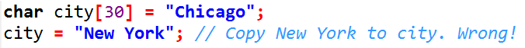
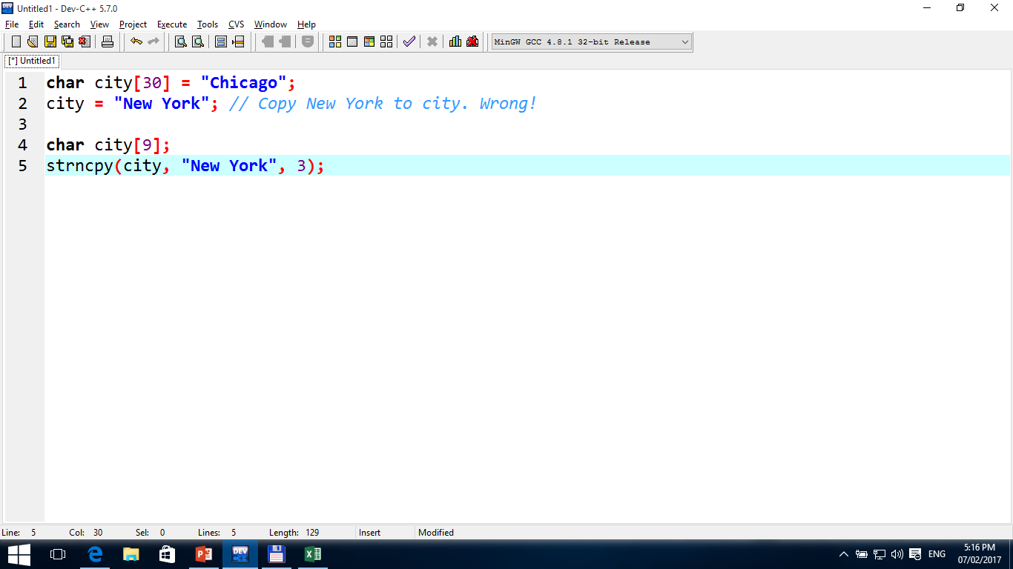
TUIT
Copying Strings Using strcpy and strncpy
Function strcpy can be used to copy a source string in the second argument to a target string in the first argument. The target string must have already been allocated sufficient memory for the function to work. A common mistake is to copy a C-string using code like this:
In order to copy “New York” to city, you have to use

Slide 35
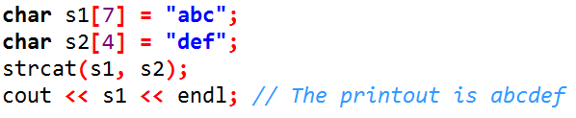
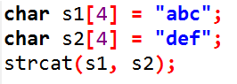
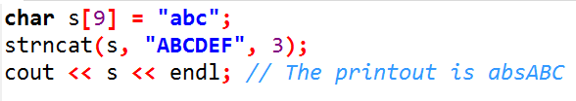
TUIT
Concatenating Strings Using strcat and strncat
Function strcat can be used to append the string in the second argument to the string in the first argument. For example, the following code works fine to append s2 into s1.
The strncat function works like strcat, except that it takes a third argument specifying the number of the characters to be concatenated from the target string with the source string.
However, the following code does not work, because there is no space to add s2 into s1.

Slide 36
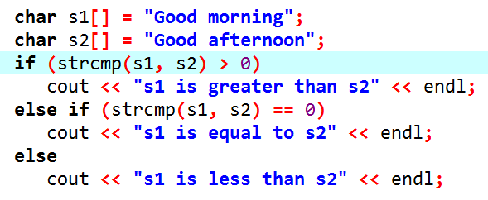
TUIT
Comparing Strings Using strcmp
Parameters can be passed by reference, which makes the formal parameter an alias of the actual argument. Thus, changes made to the parameters inside the function also made to the arguments.
It displays s1 is greater than s2.

Slide 37
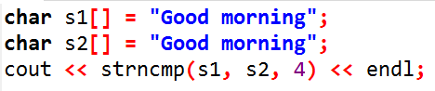
TUIT
Comparing Strings Using strcmp
The strncpy function works like strcmp, except that it takes a third argument specifying the number of the characters to be compared. For example, the following code compares the first four characters in the two strings.
It displays 0.

Slide 38
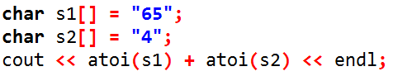
TUIT
Conversion between Strings and Numbers
Function atoi can be used to convert a C-string into an integer of the int type and function atol can be used to convert a C-string into an integer of the long type. For example. The following code converts numerical strings s1 and s2 to integers:
It displays 69.

Slide 39
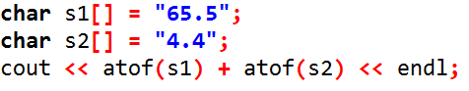
TUIT
Conversion between Strings and Numbers
Function atof can be used to convert a C-string into a floating-point number. For example, the following code converts numerical strings s1 and s2 to floating – point numbers:
It displays 69.9.

Slide 40
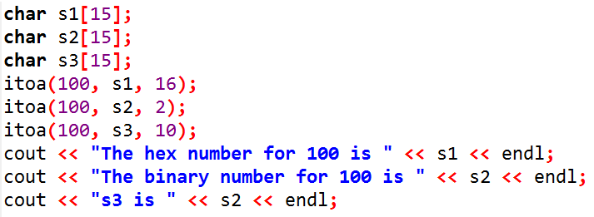
TUIT
Conversion between Strings and Numbers
Function itoa can be used to convert an integer into C-string based on a specified radix. For example, the following code
Displays
The hex number for 100 is 64
The binary number for 100 is 1100100
s3 is 100
Note that some C++ compilers may not support the itoa function.

Slide 41
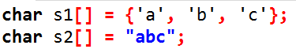
TUIT
Check Point
What are the differences between the following arrays?

Slide 42
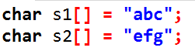
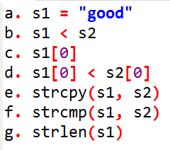
TUIT
Check Point
Suppose s1 and s2 are defined as follows:
Are the following expressions/statements correct?

Slide 43
TUIT
Summary
When an array is passed to a function, the starting address of the array is passed to the array parameter in the function.
When you pass an array argument to a function, often you also should pass the size in another argument, so the function knows how many elements are in the array.
You can specify const array parameters to prevent arrays from being accidentally modified.
An array of characters that ends with a null terminator is called a C-string.
A string literal is a C-string.
C++ provides several functions for processing C-strings.
You can obtain a C-string length using the strlen function.
You can copy a C-string to another C-string using the strcpy function.
You can compare two C-strings using the strcmp function.
You can use the itoa function to convert an integer to C-string, and use atoi to convert a string to an integer.

